Slide 1
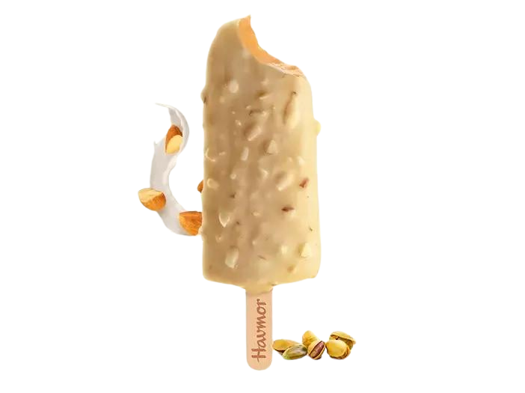
HAVMOR
Icecreams

Slide 2



Presented by
Team members
U.Deepika
U.Vimala
S.V.Sowmya
T.Pratiksha
V.Ankitha

Slide 3
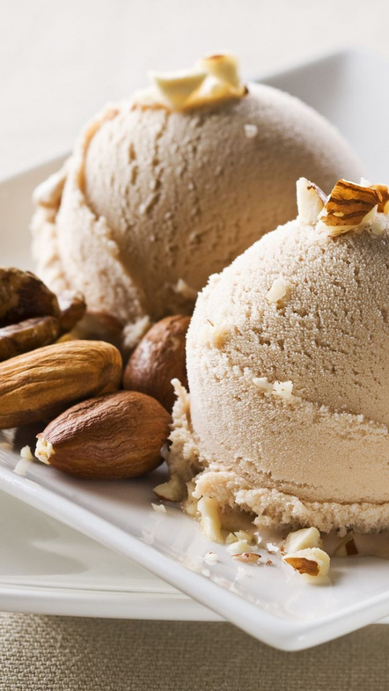
Havmor
RESEARCH BRAND IDENTITY
1. Heritage and Trust
2. Quality and Purity
3. Variety and innovation
4. Family friendly with fun
5. Affordability with Premium appeal
6. Tagline and messaging

Slide 4
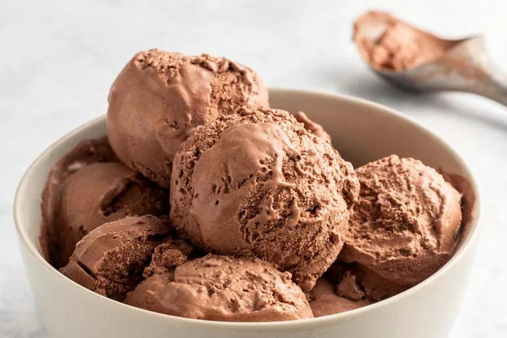
Competitor analysis
Havmor is known for its quality product and innovative flavours.Havmor is a popular ice cream brand in India known for its wide variety of flavours since 1944
Key competitors
1. Amul icecreams
2. Vadilal
3. Kwality walls
4. Cream bell
WHAT TO EXPECT
Marketing positioning
local competitors- Amul, vadilal
International compititors- Baskin Robbins,
Haagen Dazs
ice creams
kulfies
milkshakes
ice cream cakes

Slide 5
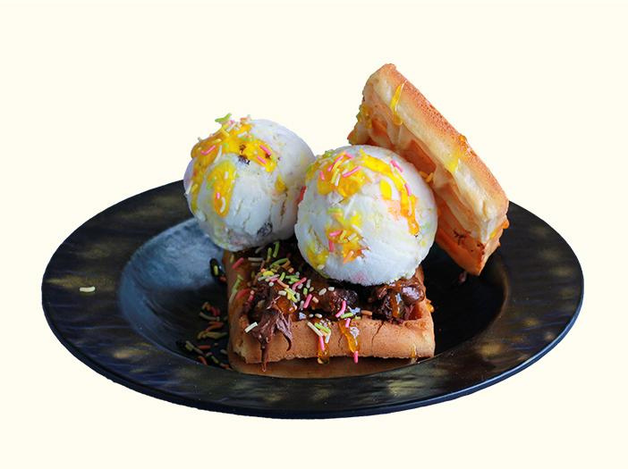
Buyer's personas
1. Family-Focused Mom (Priya, 35)
- Motivation: Quality and trust for family.
- Behavior: Budget-conscious, shops at local supermarkets.
2. Young Urban Professional (Rohan, 28)
- Motivation: Premium indulgence, convenience.
- Behavior: Shops online, influenced by social media.
3. College Student (Anjali, 20)
- Motivation: Affordable, trendy options.
- Behavior: Impulse buys, follows social media trends.
4. Health-Conscious Consumer (Rajiv, 40)
- Motivation: Healthy, guilt-free treats.
- Behavior: Shops at premium stores, reads labels carefully.

Slide 6
SEO audit
SEO audit for Havmor, a popular ice cream brand, involves evaluating various aspects of their website to ensure optimal performance in search engine rankings. Here’s a basic outline of what to look for
Off page SEO
Site speed
Mobile friendliness
Crawl errors
Backlink Profile
Social Media Presence
User Experience
Navigation
Engagement Metrics
Local Citations
Benchmarking
Google Analytics
Conversion Tracking
Technical SEO
On page SEO
Header Tags
Content Quality
Image Optimization.

Slide 7




Havmor
90%
85%
SEO audit
Site Speed
Mobile Friendliness
80%
75%
Conducted a thorough review of technical aspects such as site speed, mobile-friendliness, and crawlability to enhance search engine performance.
Crawlability
Structured Data

Slide 8
Keyword research
ICECREAM CAKE
ICECREAM BRANDS
ICECREAM PARLOUR
ICECREAM FLAVOURS

Slide 9
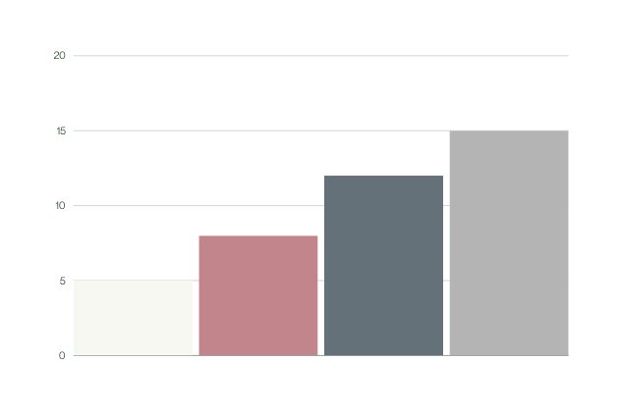
Keyword Performance Analysis
12.5
20
30
37.5
cakes
shakes
kulfies
ice creams
Evaluating the effectiveness of selected keywords in driving organic traffic and ranking on search engine results pages (SERPs).

Slide 10
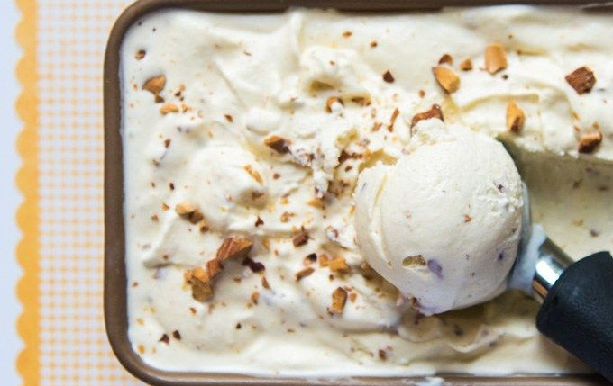
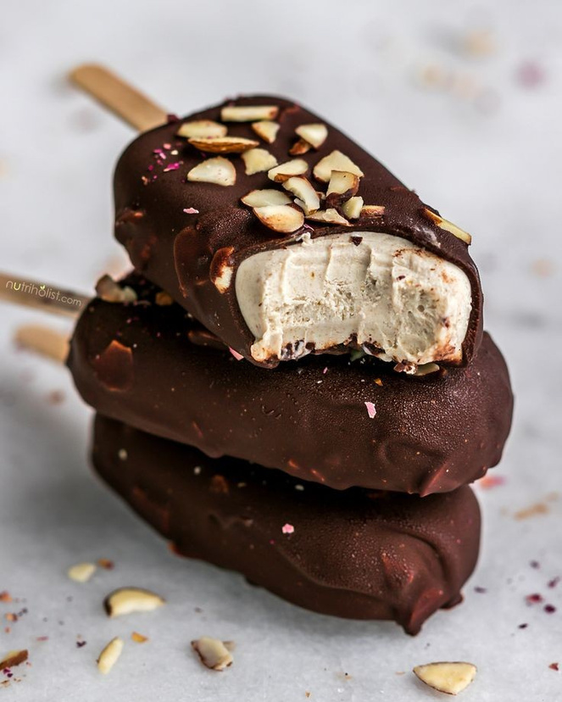
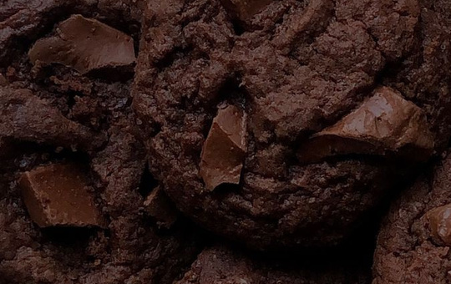
On page optimization
~Meta description- Enticing Copy: Craft descriptions that highlight unique selling points.
~Content optimization- Ensure each product page has a detailed description, highlighting the taste, ingredients, and any special features of the ice cream.
~Image optimization
~Mobile optimization
~Internal linking
~Page speed
~Local SEO

Slide 11
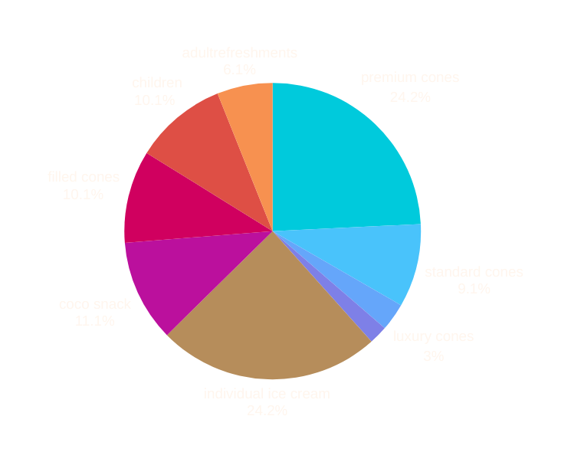
HAVMOR SALES RANGES

Slide 12
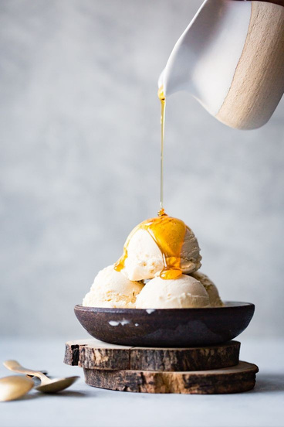
Content ideas and marketing strategy
1.Featured flavor of the month
2.Ice cream creation stories
3.Recipe Blog
4.Customer Spotlights
5.seasonal specials
6.Meet the team
7.Sustainability practices
8.Ice cream facts
9.Interactive campaigns
10. Events and collaborations

Slide 13
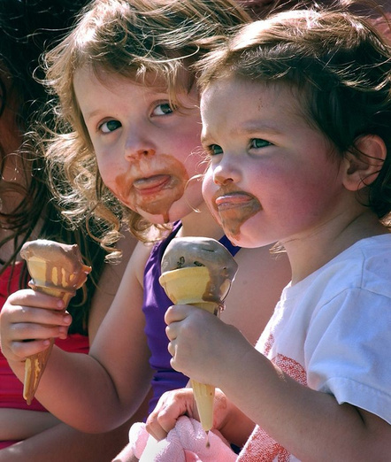
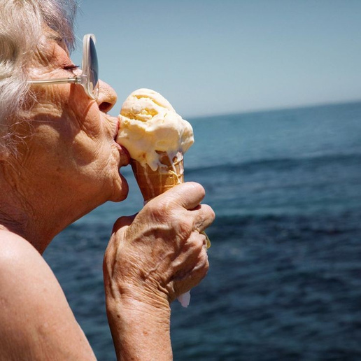

Marketing
strategies
1.Social media campaigns
2.Influencer partnerships
3.Content marketing
4.Email marketing
5.Local partnerships
6.Events and sampling
7.Loyalty programs
8.Retail promotions
9.Customer Engagement
10.Sustainability messaging
11.Geotargeted ads

Slide 14
Content creation and curation
Havmor
80 years
SUCCESSFULLY RUNNING SINCE 1944

Slide 15
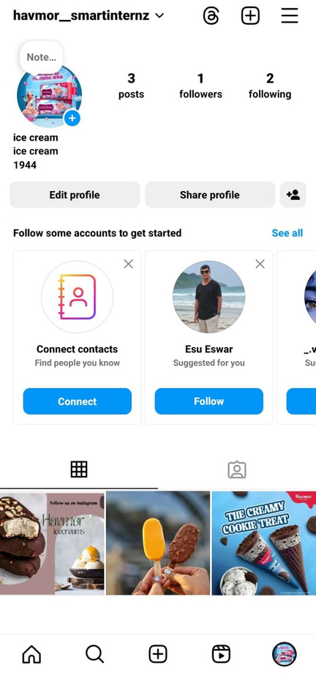
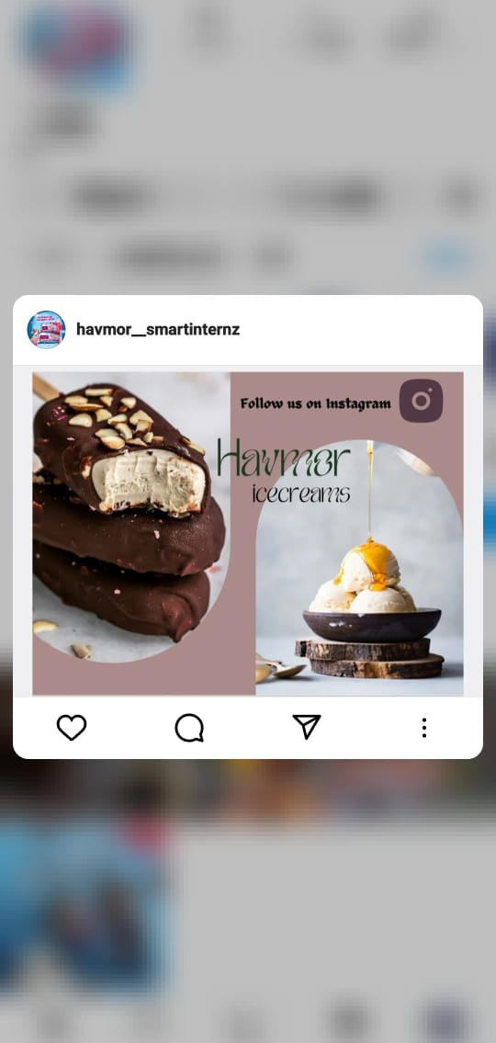
Post creation
@havmor_smartinternz
In sum, post creation is a critical aspect of digital marketing and brand management, helping to maintain a presence, engage with an audience, and drive business objectives.

Slide 16
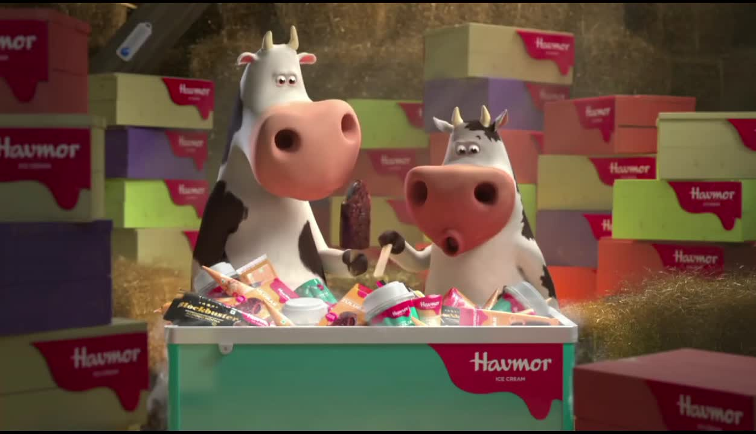
Design/video editing
Link:
https://drive.google.com/file/d/1EviT_KTtazPpGa15RftogaDDEU5XmCmC/view?usp=drivesdk

Slide 17



Social media ad campaign
TWITTER
INSTAGRAM
FACEBOOK
Presentations are communication tools.
Presentations are communication tools.
Presentations are communication tools.

Slide 18
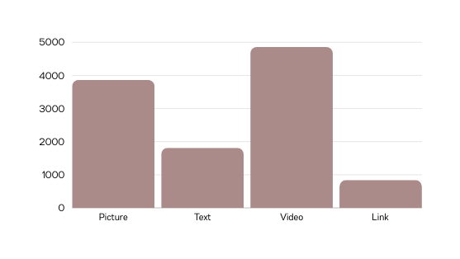
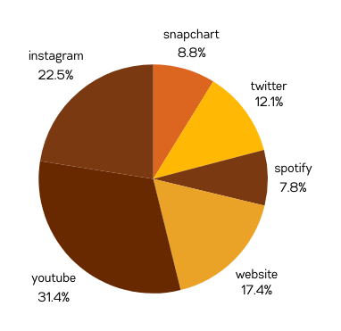
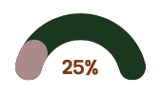
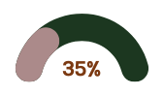
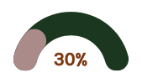
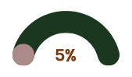
CONTENT PERFORMANCE REPORT
Analyse product campaign performance from various platforms.
Peak Engagement Times
Morning
Afternoon
Evening
Midnight

Slide 19
Email ad campaigns
Why Choose Havmore?
~Creamy Goodness
~Exciting Flavors
~Available Everywhere
Special Offer Just for You
We’ve got an exclusive offer just for our email subscribers! Get 15% off your next purchase when you use the code HAV15 at checkout. Don’t miss out—this offer is only valid until [4 th October 2025].
Ready to treat yourself? Visit our website or stop by your local store today.
Stay Cool, The Havmore Team

Slide 20


